Slide 1
Business Intelligence System for Global Sales Analysis and Customer Segmentation
Project Proposal
[AT 82 - DSAI] Business Intelligence and Analytics (BI&A)
Presented by Group 7:
Nathas Sungworawongpana (st124323),
Wut Yee Aung (st124377),
Kyi Thin Nu (st124087)
15. February. 2024 (Thursday)

Slide 2
Background
Problem Statement
In today's dynamic business landscape, organizations face the challenge of managing and extracting meaningful insights from vast and diverse datasets.
As we recognize the critical role that data plays in informed decision-making and strategic planning.
For the businesses operating across multiple countries, the need for a robust Business Intelligence (BI) System has become increasingly evident to analyze global sales trends and enhance customer segmentation for more effective decision support.
Traditional methods of analysis lack the agility and depth required to keep pace with the rapidly evolving market dynamics. Additionally, the absence of a dedicated Decision Support System (DSS) for customer segmentation hinders the business ability to tailor strategies and offerings to diverse customer segments effectively.

Slide 3
Background
In light of these challenges, we envision the implementation of a sophisticated BI system that not only consolidates and analyzes sales data from various countries but also incorporates a robust DSS for customer segmentation.
This initiative aligns with our commitment to fostering data-driven decision-making, enhancing operational efficiency, and ultimately elevating the overall competitiveness of the multi-countries platform organization.
The proposed BI system will not only address current shortcomings but also position the organization at the forefront of data-driven innovation.
By leveraging advanced analytics and visualization tools, we aim to empower the teams with actionable insights, enabling them to make informed decisions that drive business growth.
Statement 1

Slide 4
Application Domain
Business Intelligence System for Global Sales Data Analysis
Decision Support System for the Customer Segmentation

Slide 5
Objective
Analyzing sales data across multiple countries.
Creating an interactive BI dashboard for real-time insights.
Implementing a Decision Support System (DSS) for customer segmentation.
Enhancing overall business intelligence for informed decision-making

Slide 6
Description
For the data sources, we will use the dataset that is provided from the paper, “Online Retail Dataset II (Chongkolnee R. et. al. (2023))”.
The dataset contains 2 years of sales data (Year 2009-2010 and Year 2010-2011) including total 1067371 samples and 8 features.
Features:
Invoice
Stock Code
Description
Quantity
InvoiceDate
Price
CustomerID
Country
Data Source

Slide 7
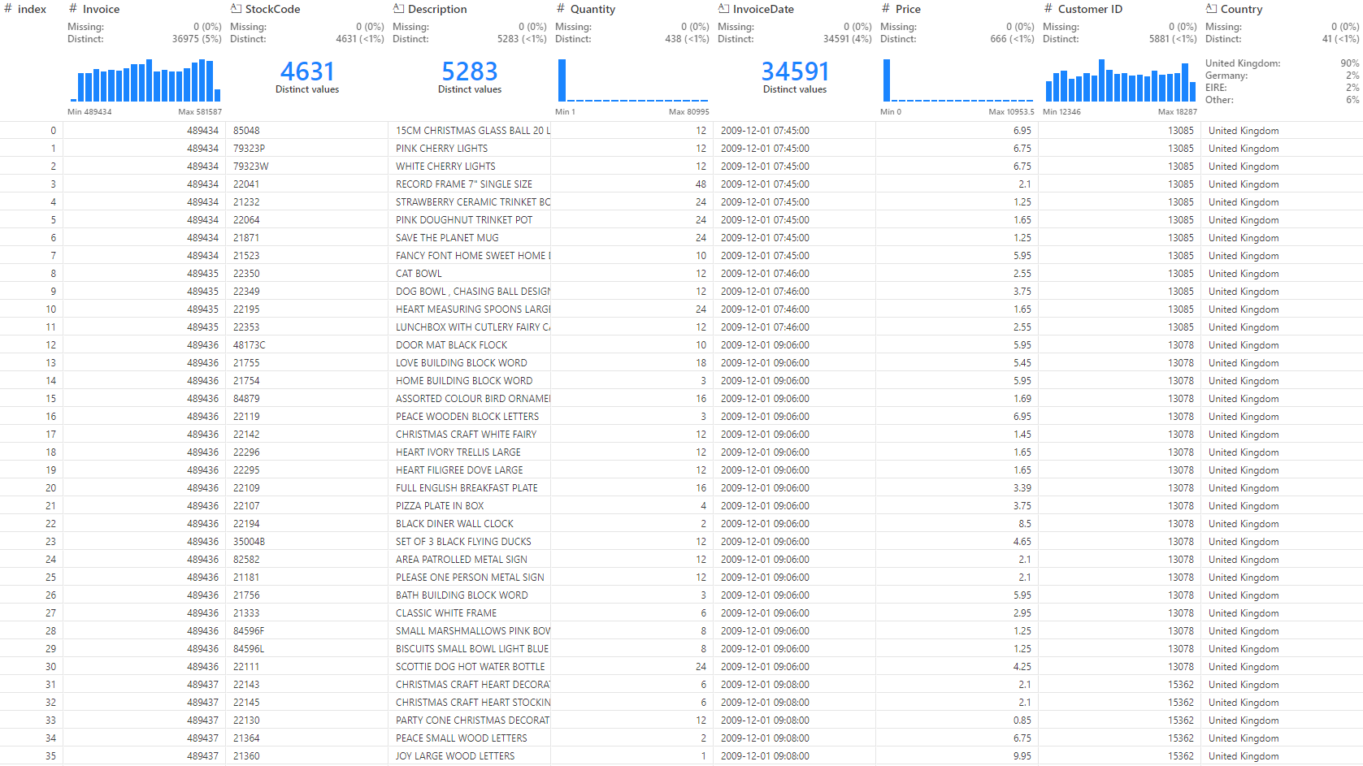

Slide 8
Description
For BI dashboard,
Analyze historical data and define key metrics to answer ‘what’ and ‘how’ of past business operations and performance.
Extract and prepare data for the key metrics from datasets.
Develop the periodical reports and Key Performance dashboard with PowerBI.
Methodology

Slide 9
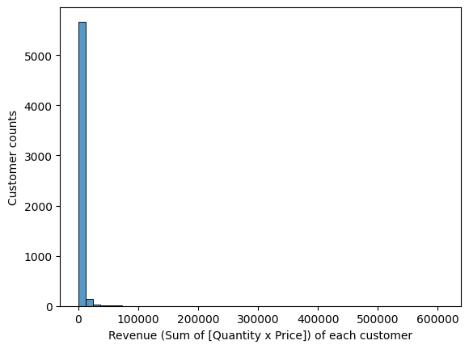
Description
Customer Segmentation
According to Chongkolnee R. et. al. (2023)†, the authors quantify customers’ purchasing amount, purchasing frequency, and time since last purchase into quantiles and segment customers based on that. The issue is the heavily skewed nature of the data, which distorts the edge quantiles. Specifically, in heavily right-skewed distributions, the edge quantiles cover an excessively wide range, rendering their qualitative information practically meaningless. To fix this, we propose to make a scoring based on the standard deviation instead.
Methodology

Slide 10
Expected Output BI and DSS
BI
A data-driven process for analyzing historical data and delivering actionable insights for business decisions.
Sales performance dashboard across regions.
Periodic reports for Customer Behavior and Segmentation
DSS
Segmented customer groups for targeted marketing campaigns, high-value customer focus, customer retention, winning back lost customers, etc.
max growth

Slide 11
Conclusion
BI system can provide either traditional or interactive reporting to assist organization in decision making.
Enables the analysis of historical data to address business questions.
Descriptive, Predictive and Prescriptive analysis support data-driven decision-making system.

Slide 12
Thank You

